Slide 1

Open Lab Series on AI in Scientific Discovery and Academic Research: Reasoning Models
Namig Abbasov, Data Science Analytics Unit, ASU Library

Slide 2

Open Lab Series Schedule
15 Oct.
Introduction, Prompt Engineering
22 Oct.
LLMs for Scientific Discovery, Reasoning Models
12 Nov.
LLMs for Qualitative Research

Slide 3
Share in Chat
Which AI tools are you currently using, and which do you find most useful? Are there any general or specialized AI tools you’d like us to cover in future sessions?

Slide 4
Outline
Reasoning Models in LLM development steps
How to Build Reasoning Models
Understanding Reasoning Models
Use Cases of Reasoning Models

Slide 5
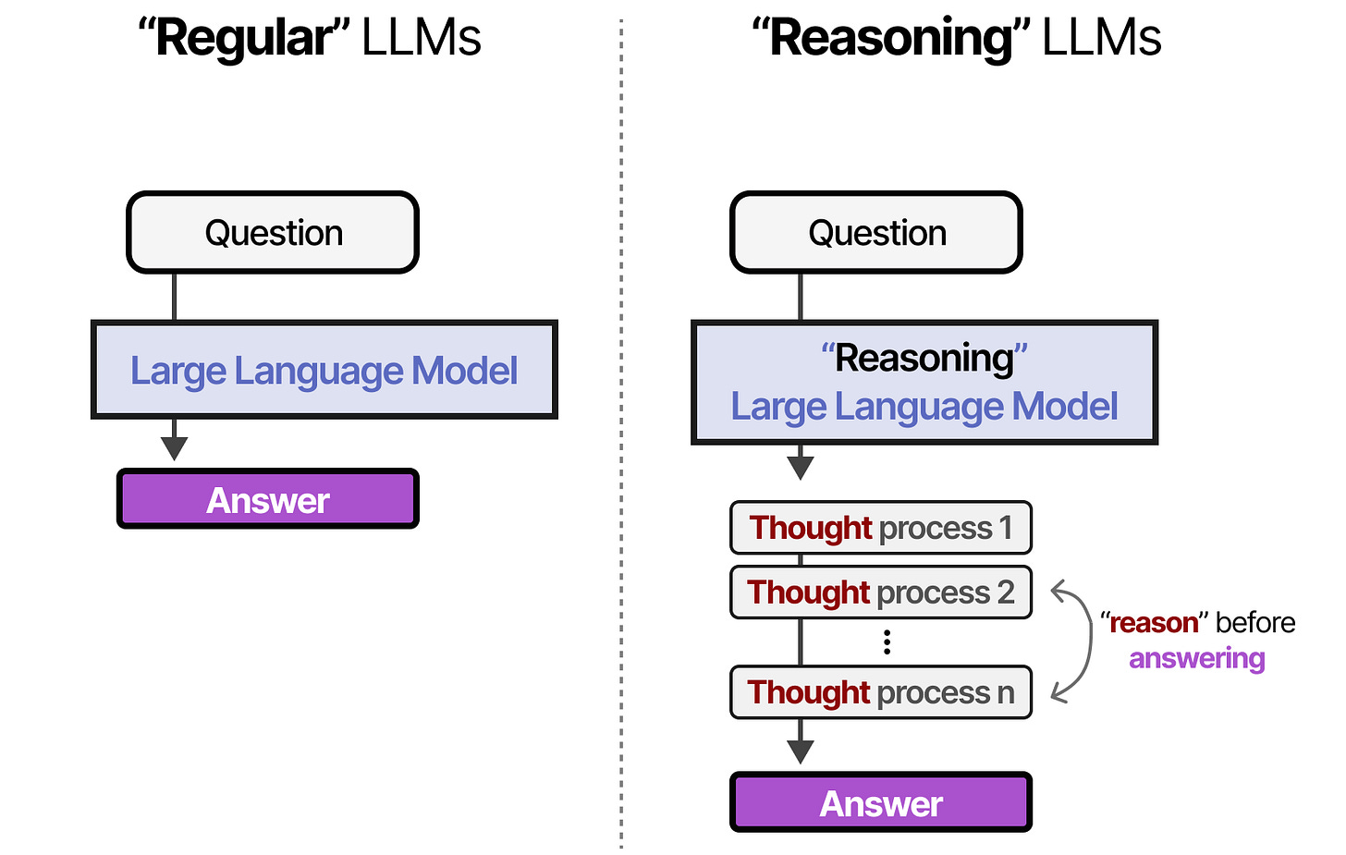
Defining Reasoning Models
“process of answering questions that require complex, multi-step generation with intermediate steps”(Raschka 2025)

Slide 6
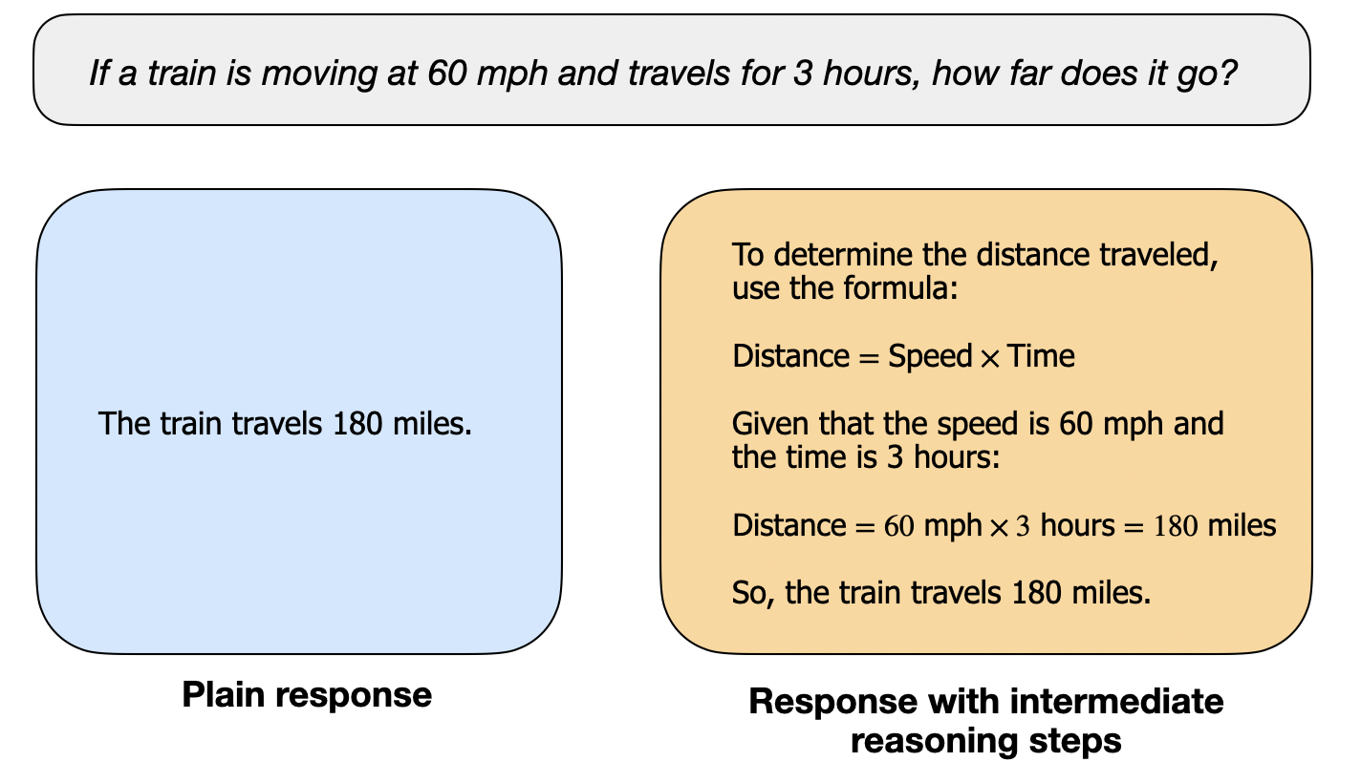
Regular LLM vs Reasoning LLM

Slide 7
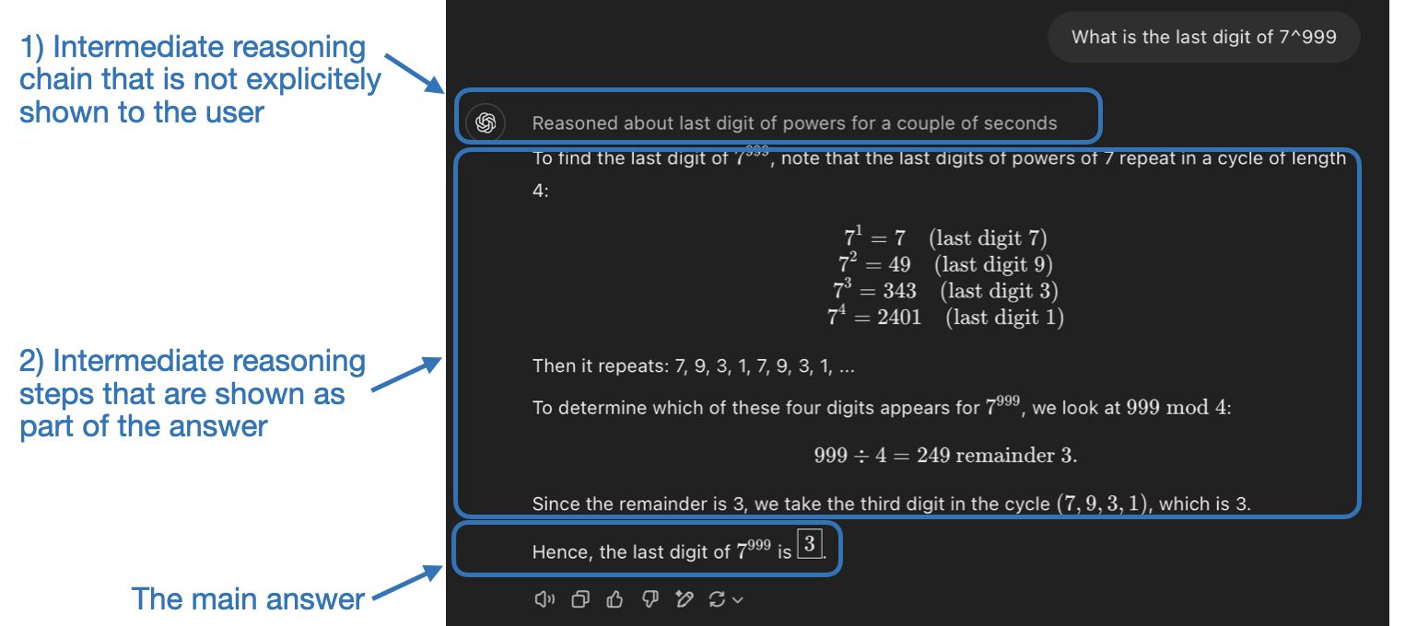
Intermediate Steps in Reasoning Models

Slide 8
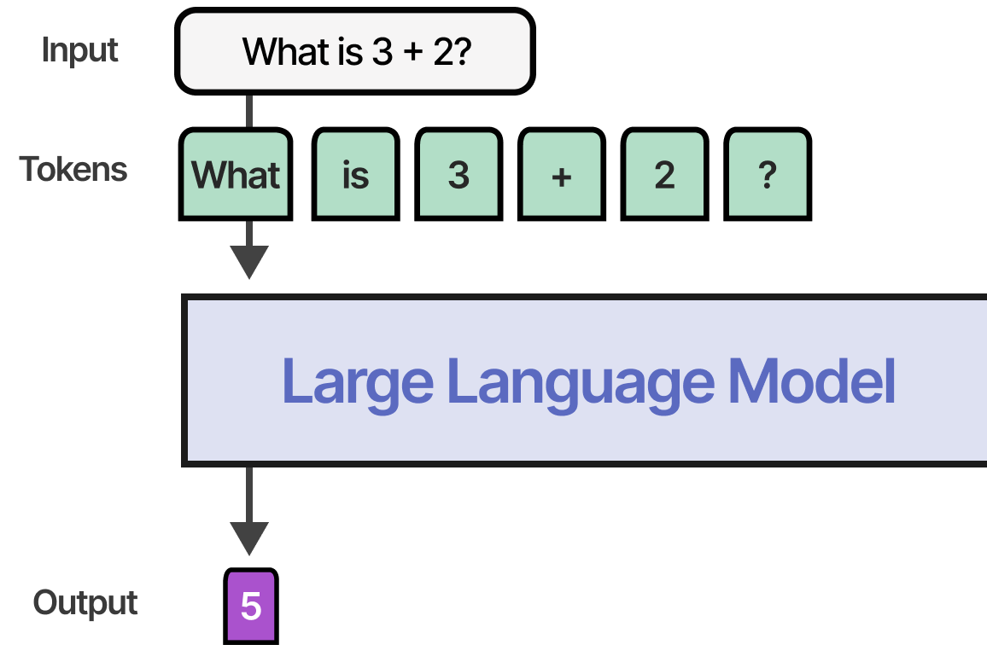
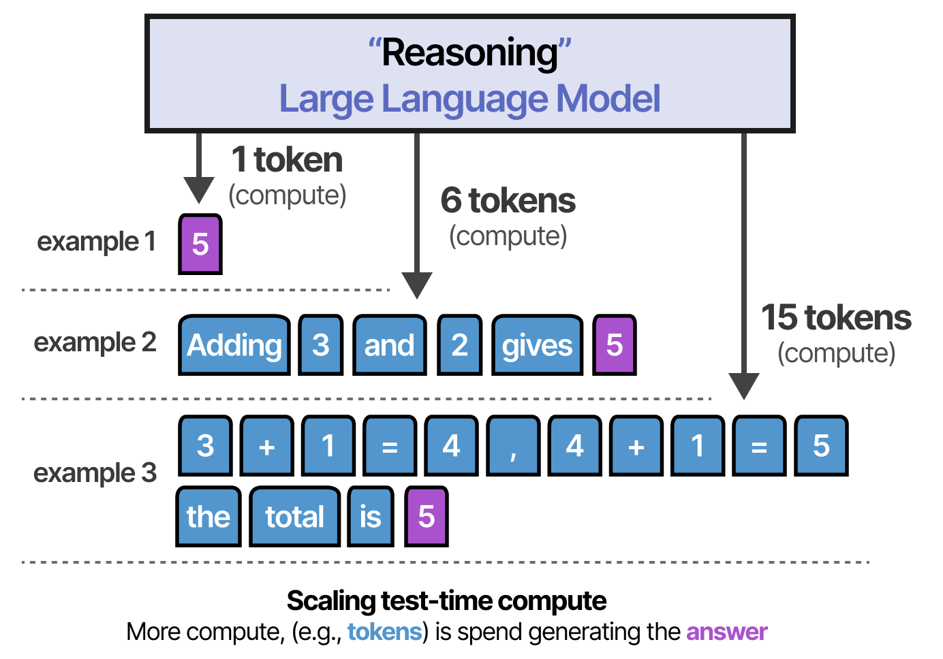
Why Reasoning Models Use More Tokens

Slide 9
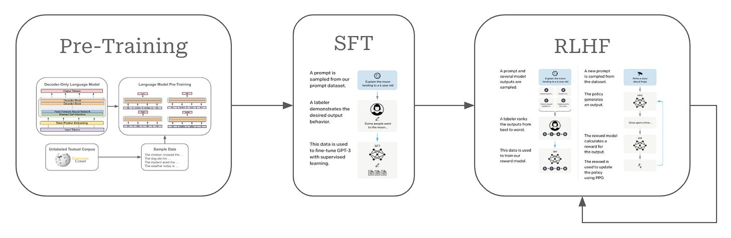
How Reasoning Models Built: Reminder of LLM Development Stages
Wolfe 2025
Notes:
https://cameronrwolfe.substack.com/p/demystifying-reasoning-models

Slide 10
Pre-training with Self-Supervised
Input | Target (next token)
“Artificial” | “intelligence”
“Artificial intelligence” | “is”
“Artificial intelligence is” | “transforming”
“Artificial intelligence is transforming” | “the”
“Artificial intelligence is transforming the” | “world”
“Artificial intelligence is transforming the world” | “.”

Slide 11
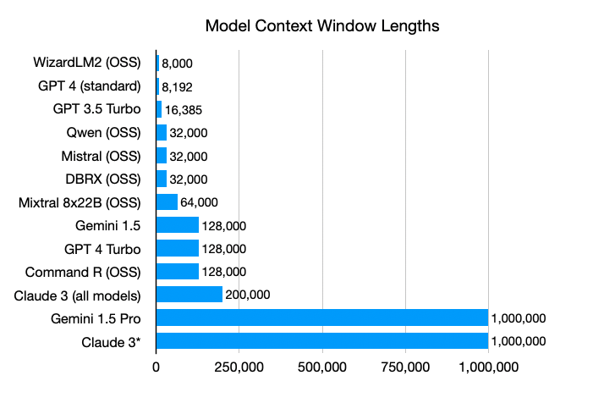
Notes:
https://www.zenml.io/blog/bigger-isnt-always-better-the-case-for-rag-in-the-age-of-infinite-context

Slide 12
Supervised Fine-Tuning: General Knowledge
User: Explain why sky is blue.
Assistant: The sky appears blue because molecules in the atmosphere scatter sunlight, and shorter wavelengths like blue are scattered more than longer wavelengths such as red. This scattering causes us to see the sky as blue during the day.

Slide 13
Supervised Fine Tuning: Summarization
User: Summarize following paragraph: “Artificial intelligence is transforming education by personalizing learning, providing instant feedback, and automating administrative tasks.”
Assistant: AI improves education by tailoring lessons to students, giving immediate feedback, and reducing teachers’ administrative workload.

Slide 14
Supervised Fine-Tuning: Creative Writing
User: Write a short poem about fall leaves.
Assistant: Golden whispers fill the air, Leaves drift softly without care. Crimson carpets line the ground, Autumn’s hush, a gentle sound.

Slide 15
Reinforcement Learning from Human Feedback
Combines reinforcement learning with human judgments.
Aligns model behavior with human values.
Used in models like ChatGPT for better responses.
Challenges: bias, cost, scalability, consistency.

Slide 16
Reinforcement Learning from Human Feedback - RLHF
Prompt: Explain why exercise is important.
Response
A: Exercise helps maintain physical health, improves mood, and increases energy levels.
B: Exercise is good.
Preferred A: Reward model will learn:
A = higher reward (detailed, helpful)
B = lower reward (too vague)

Slide 17
LLM Development Stages
Pretraining = Learn language.
SFT = Learn to follow instructions.
RLHF = Learn to follow human preferences.

Slide 18
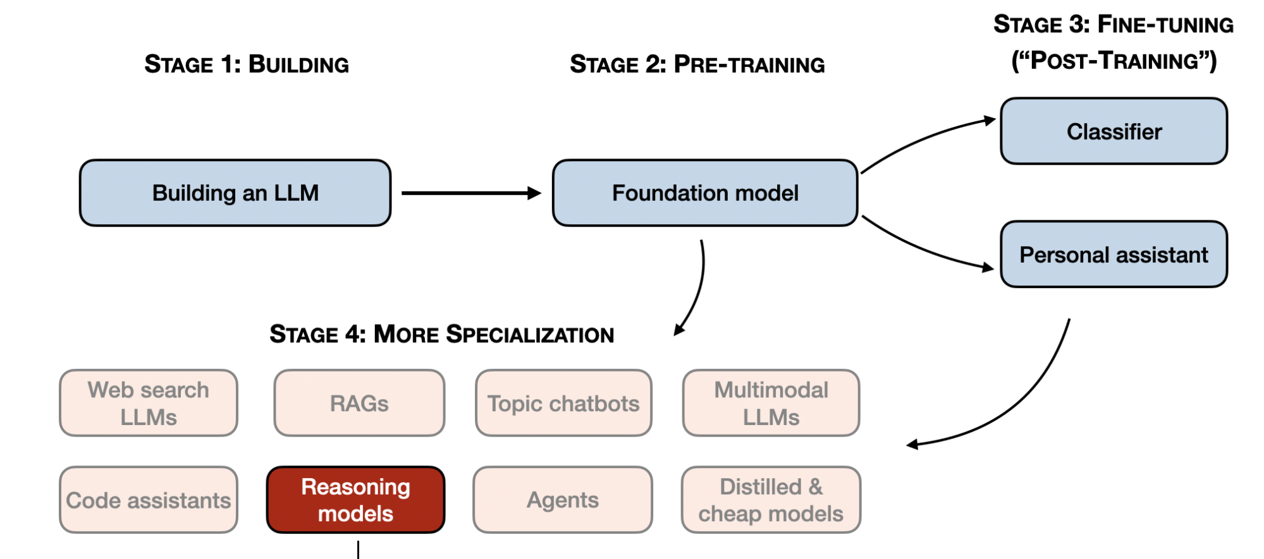
Reasoning Models in LLM Development Stages

Slide 19
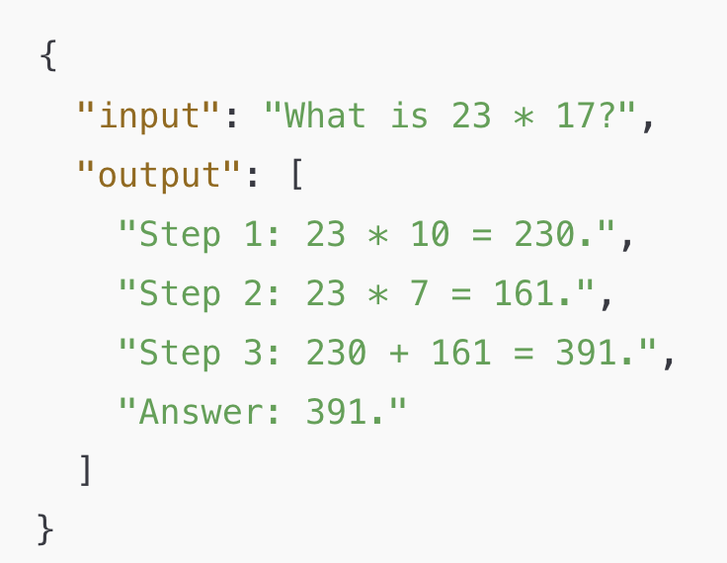
Reasoning Model Data

Slide 20
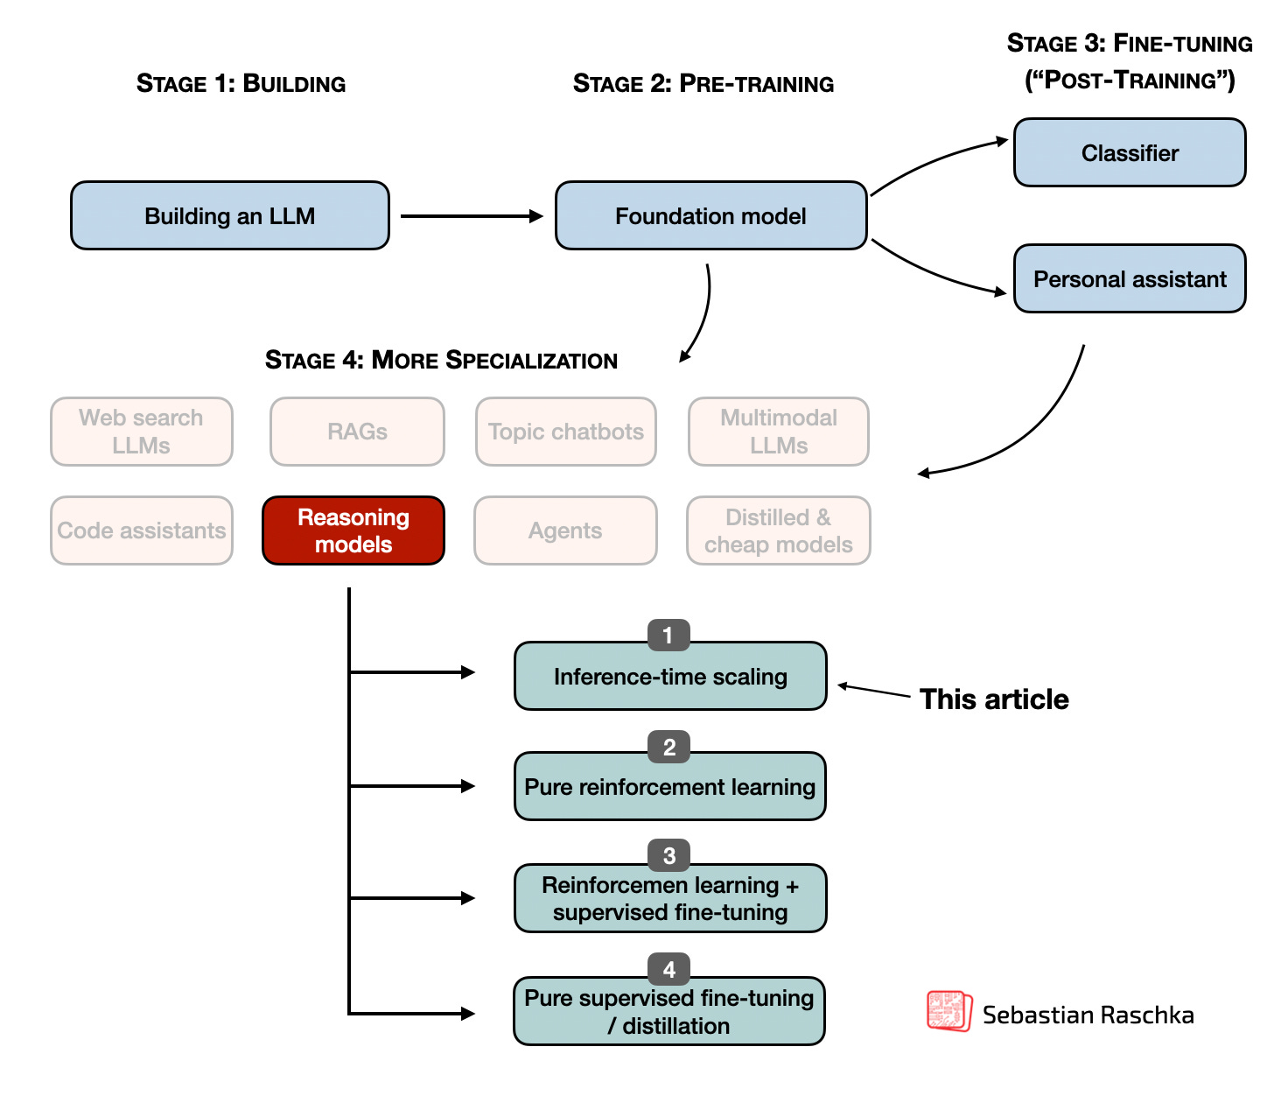
Main Ways to Build Reasoning Models
Inference-time scaling
Pure reinforcement learning
Supervised finetuning and reinforcement learning
Pure supervised finetuning (SFT) and distillation

Slide 21
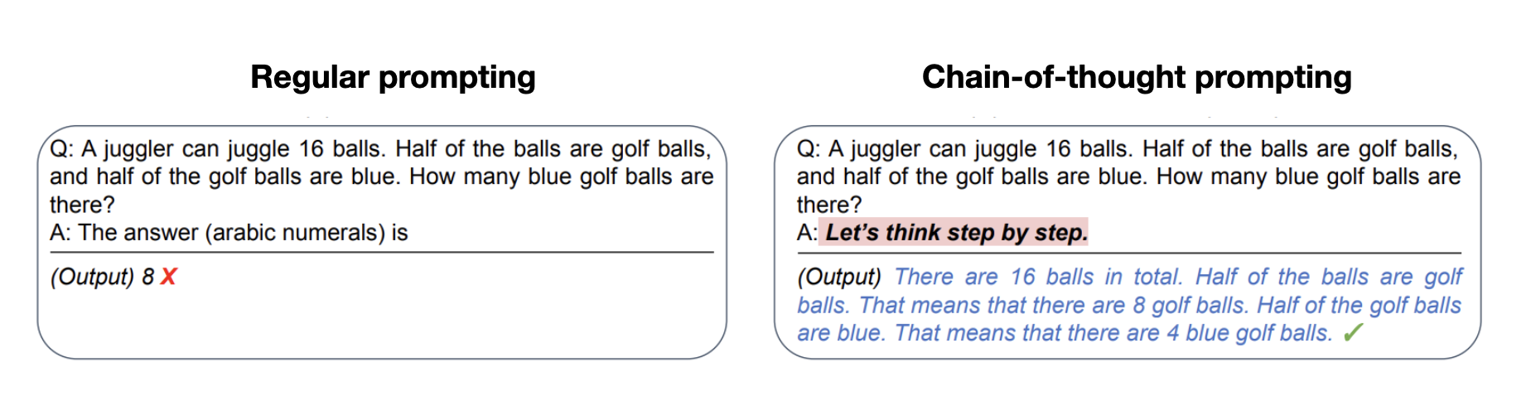
Inference-Time Scaling: Chain-of-Thought Prompting
Kojima et. al 2022

Slide 22
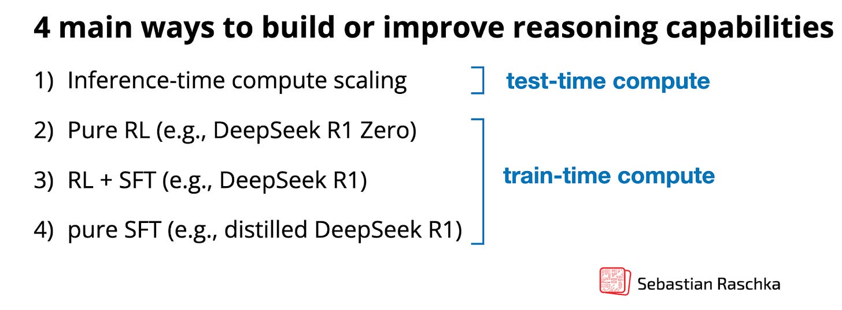
Test-Time Compute vs Train-Time Compute

Slide 23
When to Use Reasoning Models?
Why: using reasoning models for everything is expensive and ineffective
Computational Overhead
Higher Risk of “Overthinking” or Hallucination
Reduced Throughput and Scalability
Complex Reasoning and Problem Solving
scientific discovery: brainstorm research ideas
reasoning through counterfactual scenarios
designing a novel experiment with constraints
planning a multi-step data science pipeline
advanced math problems
challenging coding tasks
Inefficient for Simpler Tasks
Grammar correction
Simple definitions
Text summarization
Translation
Fact-based question answering

Slide 24
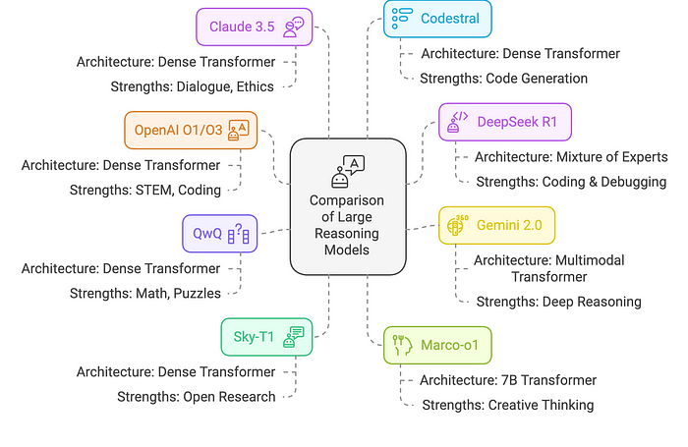
Primary Reasoning Models
OpenAI O1/O3
DeepSeek R1
Gemini 2.0 (Flash Thinking)
QwQ (Alibaba)
Sky-T1
Marco-o1
Claude 3.5
Codestral (Mistral)

Slide 25
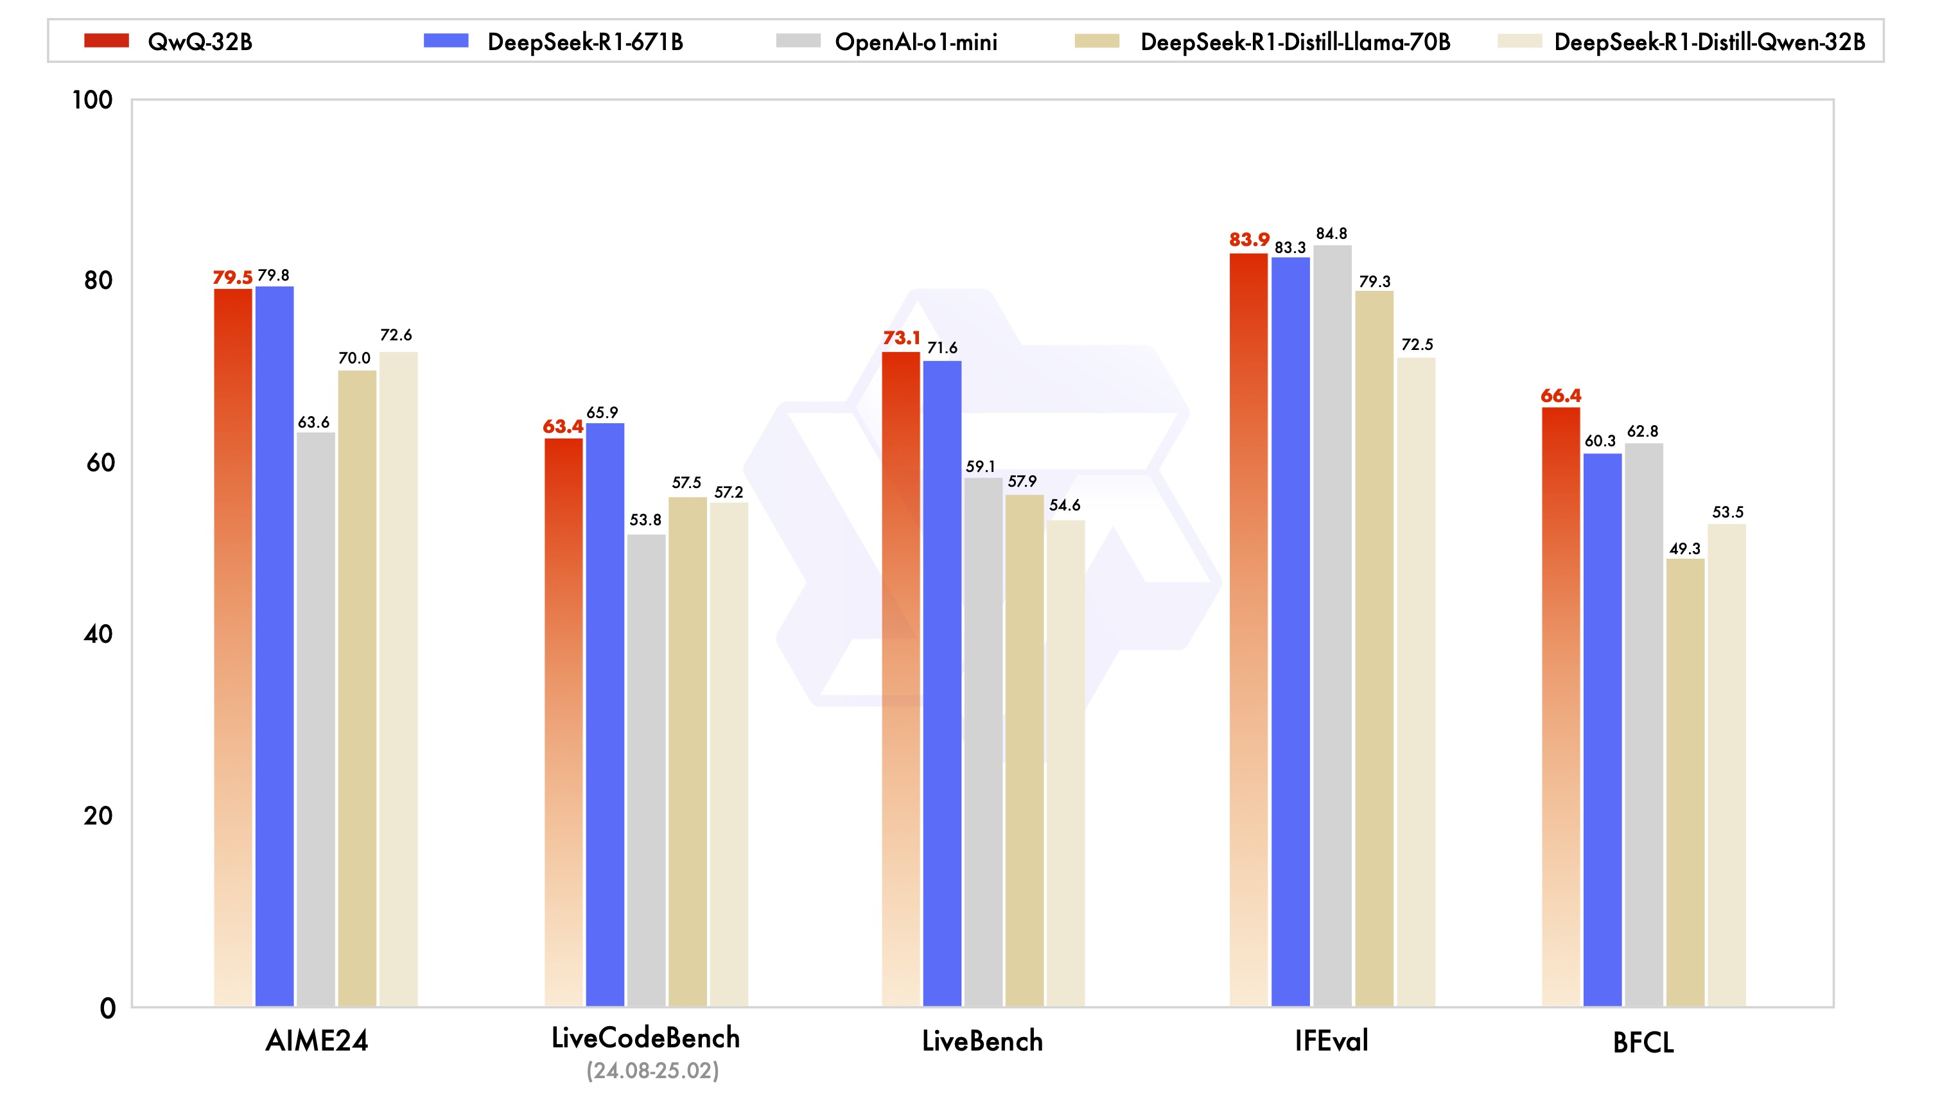
Performance of Reasoning Models

Slide 26
Caveats
Do these models really reason? [topic of another workshop]
To reason, you need to understand
Do these models really understand?
Next token prediction vs understanding
No Real World Model
No internal model of physics, time, or environment.
struggle with tasks that require understanding of how world works
something Yann LeCun’s team works [another workshop, see paper ]
Hallucination Risk
Remember how Transformer architecture works
Check Everything!
You are the expert, models can only assist!

